Slide 1

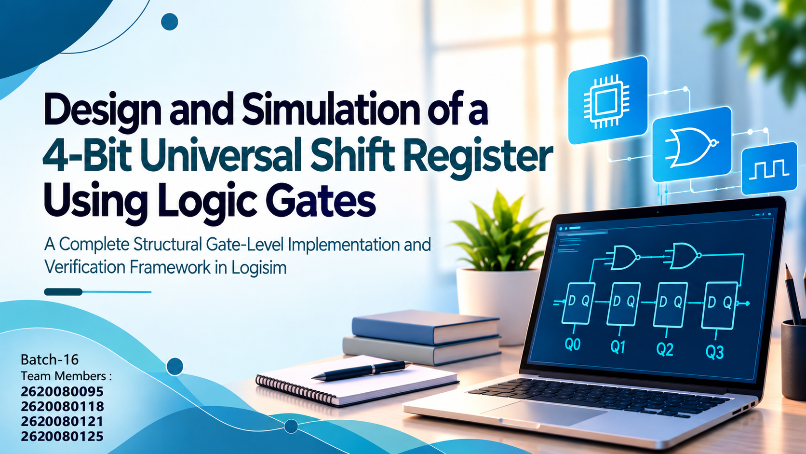

Design and Simulation of a 4-Bit Universal Shift Register Using Logic Gates
A Complete Structural Gate-Level Implementation and Verification Framework in Logisim

Slide 2

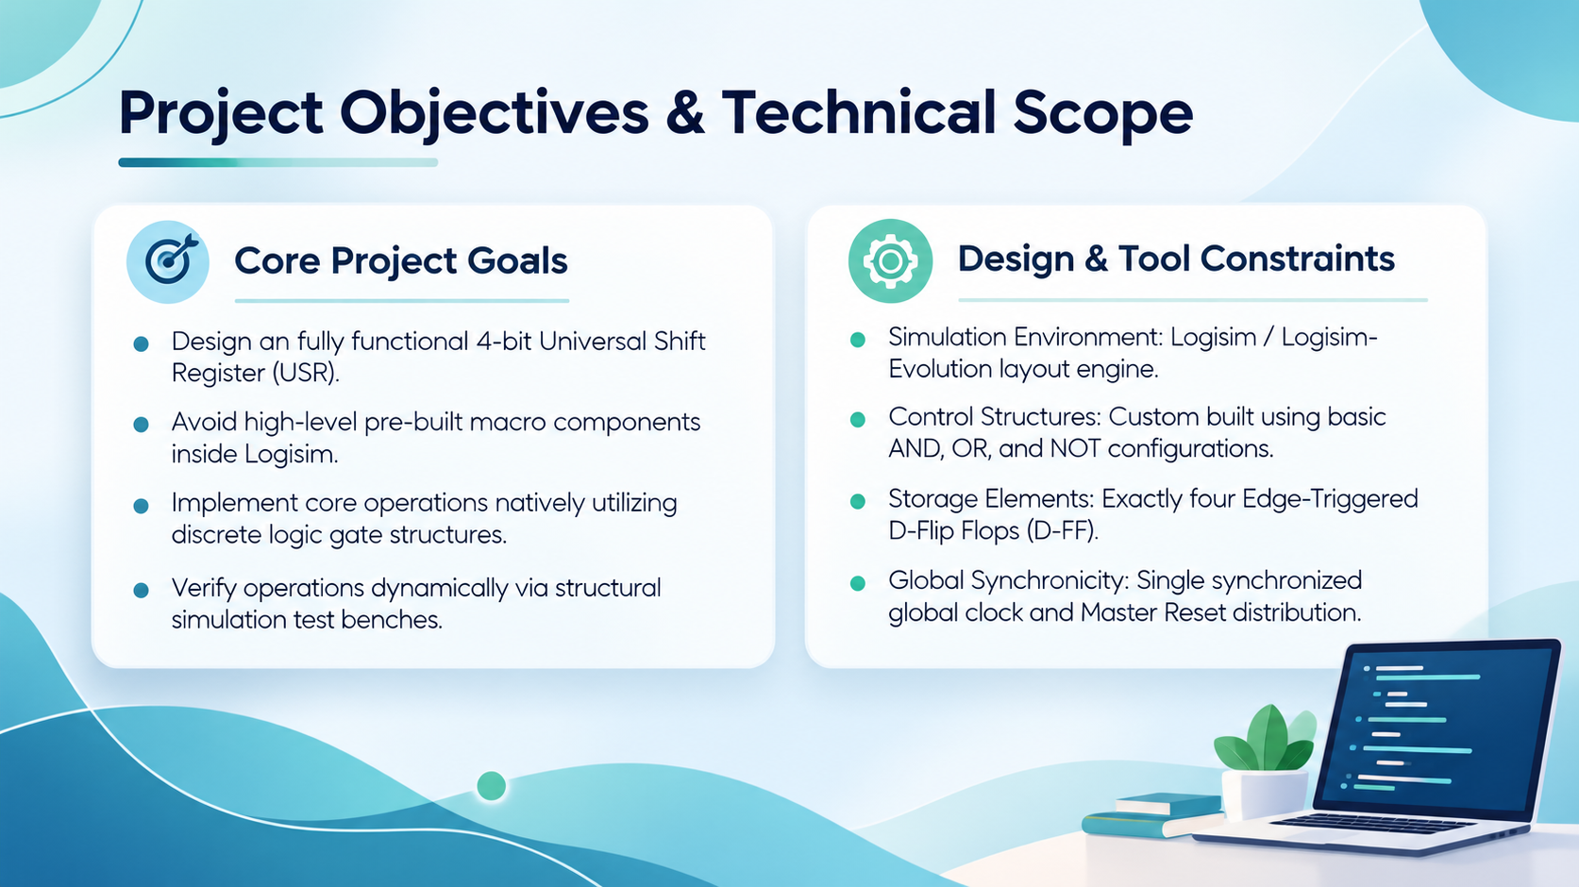
Project Objectives & Technical Scope
Core Project Goals
• Design an fully functional 4-bit Universal Shift Register (USR).
• Avoid high-level pre-built macro components inside Logisim.
• Implement core operations natively utilizing discrete logic gate structures.
• Verify operations dynamically via structural simulation test benches.
Design & Tool Constraints
• Simulation Environment: Logisim / Logisim-Evolution layout engine.
• Control Structures: Custom built using basic AND, OR, and NOT configurations.
• Storage Elements: Exactly four Edge-Triggered D-Flip Flops (D-FF).
• Global Synchronicity: Single synchronized global clock and Master Reset distribution.

Slide 3
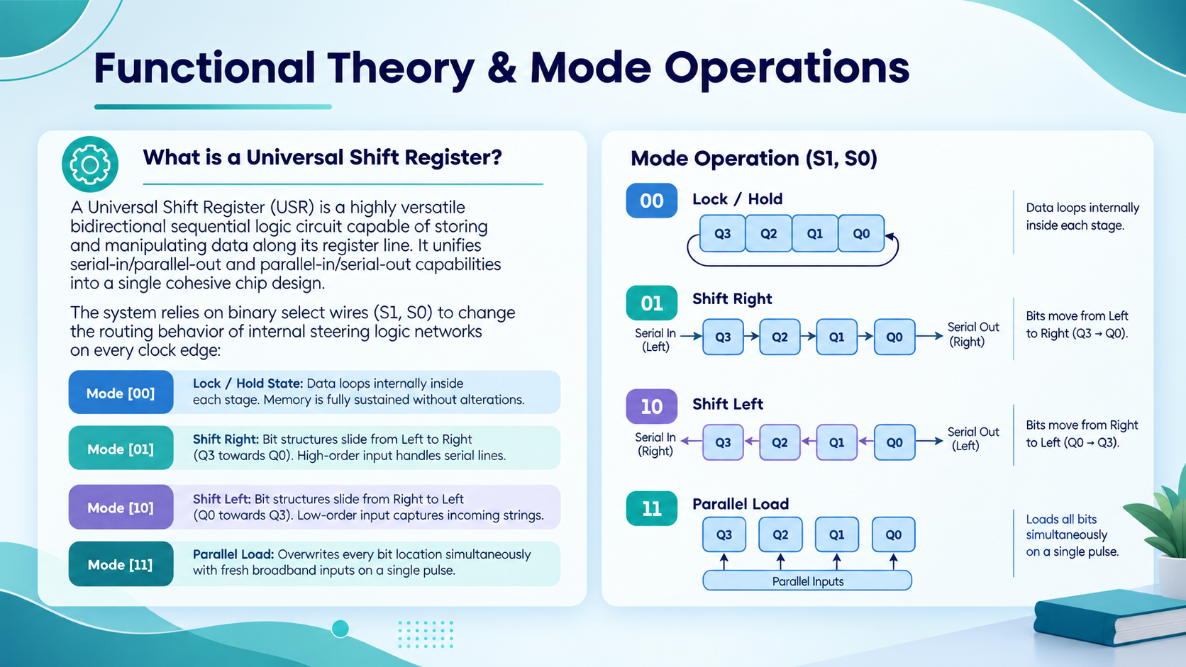
Functional Theory & Mode Operations
What is a Universal Shift Register?
A Universal Shift Register (USR) is a highly versatile bidirectional sequential logic circuit capable of storing and manipulating data along its register line. It unifies serial-in/parallel-out and parallel-in/serial-out capabilities into a single cohesive chip design.
The system relies on binary select wires (S1, S0) to change the routing behavior of internal steering logic networks on every clock edge:
➔ Mode [00] - Lock / Hold State: Data loops internally inside each stage. Memory is fully sustained without alterations.
➔ Mode [01] - Shift Right: Bit structures slide from Left to Right (Q3 towards Q0). High-order input handles serial lines.
➔ Mode [10] - Shift Left: Bit structures slide from Right to Left (Q0 towards Q3). Low-order input captures incoming strings.
➔ Mode [11] - Parallel Load: Overwrites every bit location simultaneously with fresh broadband inputs on a single pulse.

Slide 4
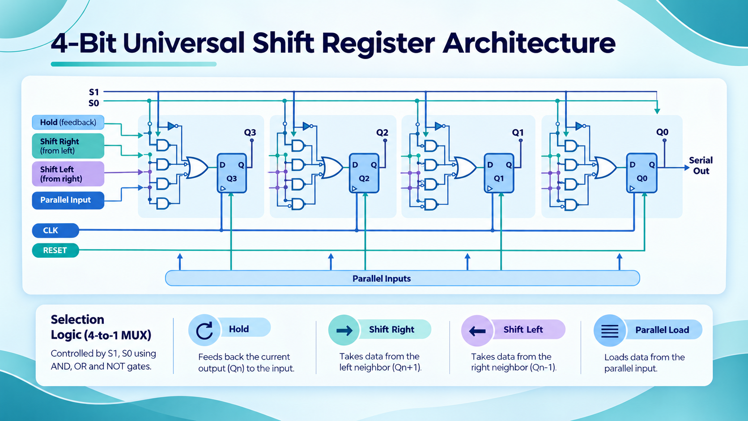
System Truth Table & Routing Rules
S1 (Select 1) | S0 (Select 0) | Operation Mode | Data Steering Logic Path
0 | 0 | Hold / No Change | Qn ➔ Dn (Output tracks back to own input)
0 | 1 | Shift Right | Qn+1 ➔ Dn (Serial input right hooks into Stage 3)
1 | 0 | Shift Left | Qn-1 ➔ Dn (Serial input left hooks into Stage 0)
1 | 1 | Parallel Load | In ➔ Dn (All external lines load simultaneously)

Slide 5
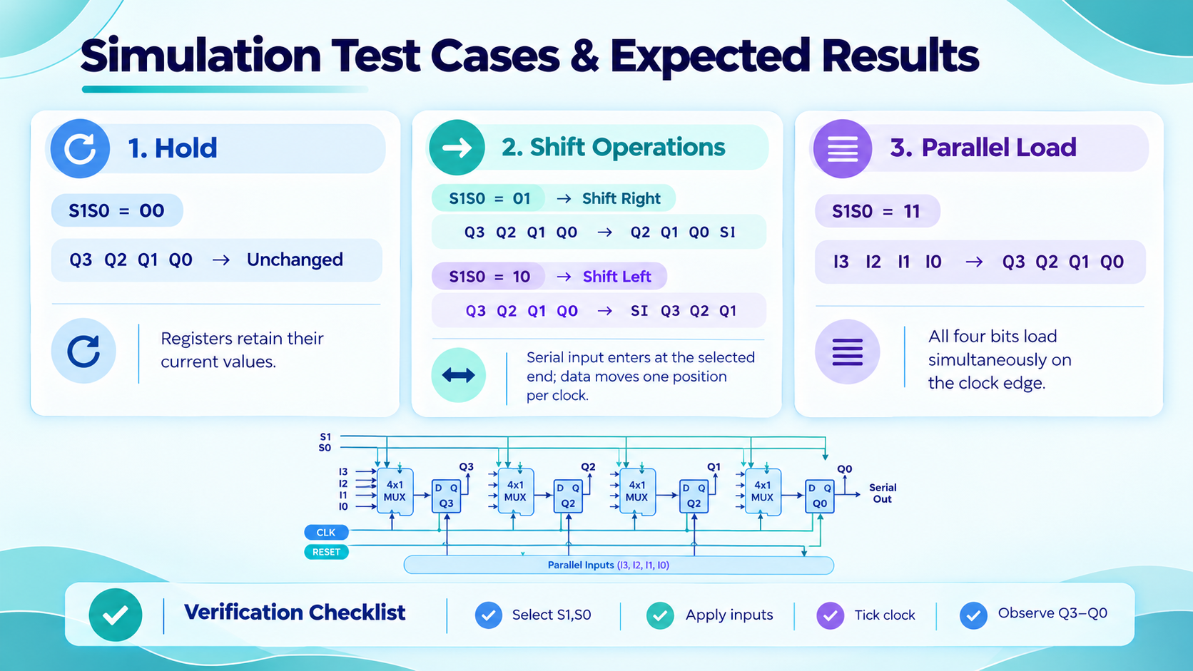
Logisim Tool Setup & Step-by-Step Simulation
1. Main Circuit Assembler
Instantiate 4 instances of your custom MUX sub-circuit alongside 4 standard D-Flip Flops from Logisim's 'Memory' library tree. Wire the MUX outputs directly to the D-inputs.
2. Control Routing
Tie the Clock inputs of all 4 flip-flops together to a single global Clock item. Join the select wires S1 and S0 of all four MUX blocks together using a unified 2-bit Input Switch element.
3. Interactive Execution
Use Logisim's 'Poke Tool' (Hand Icon) to dynamically alter the values of input pins. Step the system using Ctrl+T (Simulate ➔ Tick Half Cycle) to force register evaluations.

Slide 6
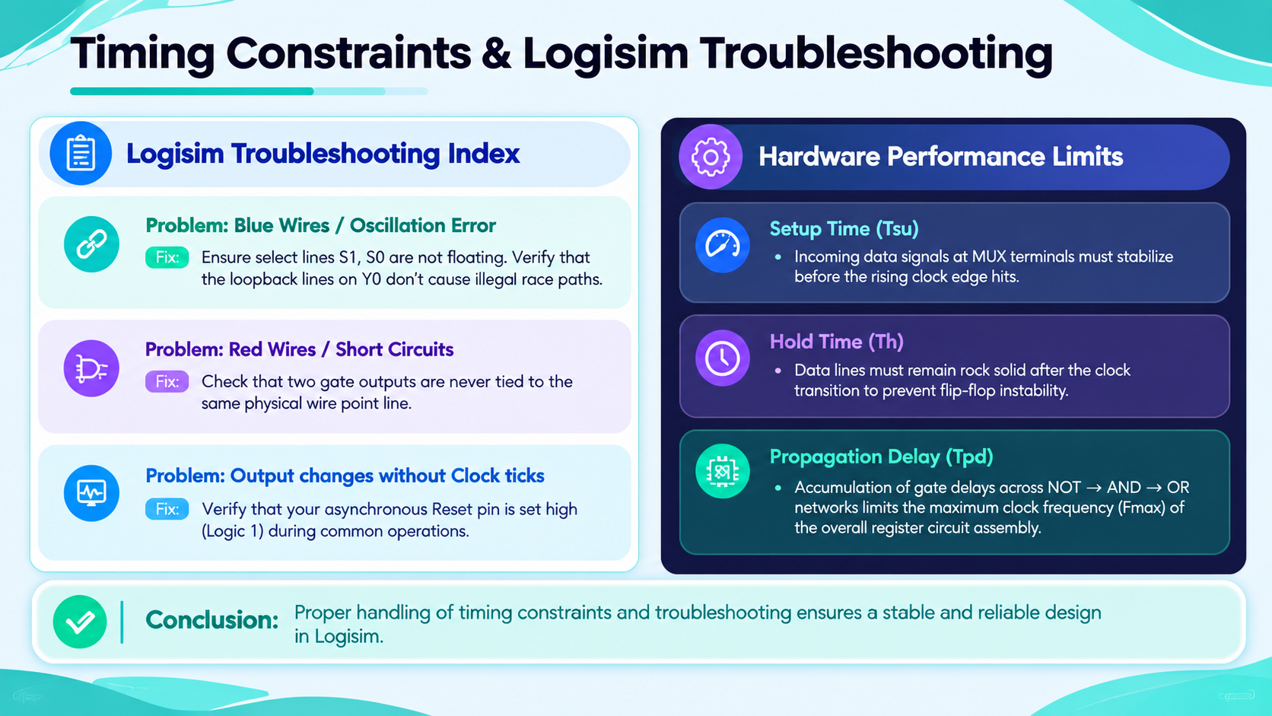
Timing Constraints & Logisim Troubleshooting
Logisim Troubleshooting Index
Problem: Blue Wires / Oscillation Error
Fix: Ensure select lines S1, S0 are not floating. Verify that the loopback lines on Y0 don't cause illegal race paths.
Problem: Red Wires / Short Circuits
Fix: Check that two gate outputs are never tied to the same physical wire point line.
Problem: Output changes without Clock ticks
Fix: Verify that your asynchronous Reset pin is set high (Logic 1) during common operations.
Hardware Performance Limits
• Setup Time (Tsu): Incoming data signals at MUX terminals must stabilize before the rising clock edge hits.
• Hold Time (Th): Data lines must remain rock solid after the clock transition to prevent flip-flop instability.
• Propagation Delay (Tpd): Accumulation of gate delays across NOT ➔ AND ➔ OR networks limits the maximum clock frequency (Fmax) of the overall register circuit assembly.

Slide 7


